Slide 1

Networking and APIs in Mobile Applications
Understanding REST APIs, real-time communication, and secure data transfer.

Slide 2

Network Communication
in Mobile Apps
Neworking is the process of enabling a mobile app to connect to the internet or other devices, allowing it to exchange data, download files, and communicate with servers
API Calls
Data Transfer
Apps interact with APIs through HTTP requests.
JSON is a common data format for mobile apps.

Slide 3

Introduction to APIs in Applications
Definition
Types
An API (Application Programming Interface) allows apps to communicate with external services.
REST
SOAP
GraphQL

Slide 4
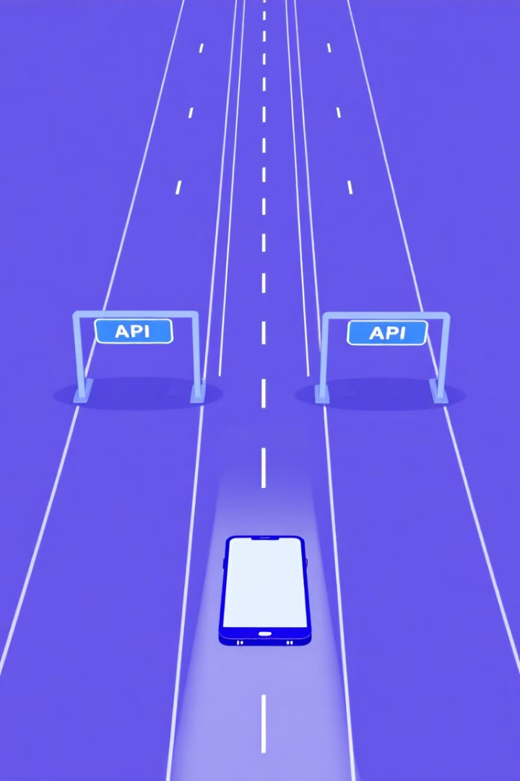
Demystifying APIs
APIs (Application Programming Interfaces) are the tollbooths of the information highway, granting your app access to external services' data and functionalities. Think of them as specialized libraries offering capabilities like weather forecasts, social media updates, or news feeds.
Key Features of APIs:
Access specific data and functionalities.
Use well-defined communication protocols.
Often require authentication and authorization.
Can be public or private, with different access levels.

Slide 5
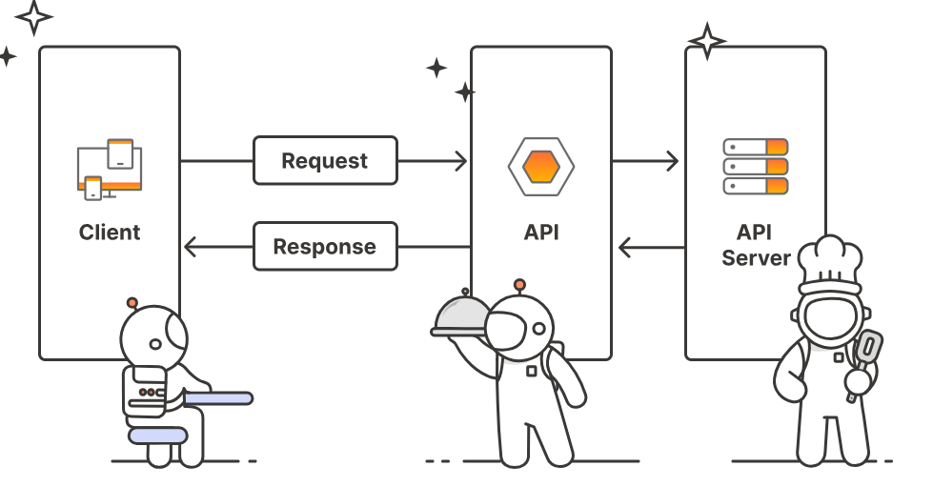
How does API work?
1️⃣ Client Makes a Request
A client (e.g., mobile app, website) sends a request to an API.
2️⃣ API Sends the Request to the Server
The API processes the request and forwards it to the backend server.
If authentication is needed, the API checks for a valid API key or token.
3️⃣ Server Processes the Request
The server retrieves or updates data from the database.
If the request is valid, the server processes it and prepares a response.
4️⃣ API Sends the Response Back to the Client
The API sends the response in a structured format like JSON or XML.
If the request is successful, the response contains the requested data.
If the request fails, the response contains an error message (e.g., 404 Not Found).

Slide 6
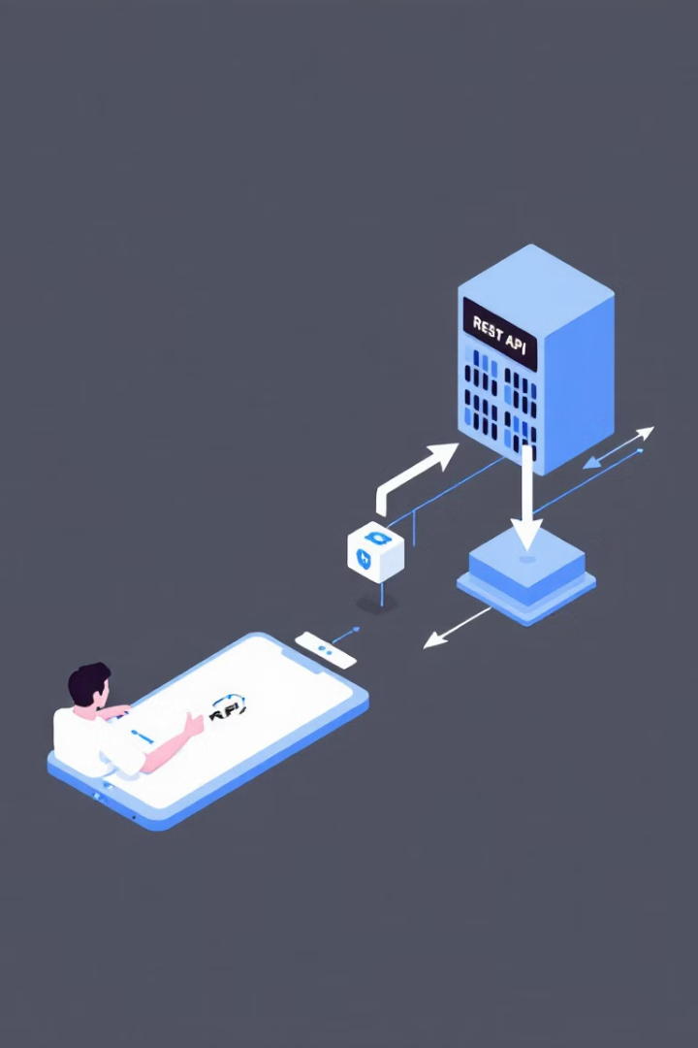
What is a RESTful API?
1
Definition
A RESTful API is an architectural style for an application programming interface that uses HTTP requests to access and use data.
2
Characteristics
Stateless
Uses HTTP Methods (GET, POST, PUT, DELETE)
Communicates via JSON/XML

Slide 7
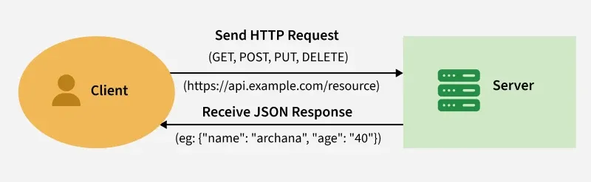
How does RESTful API work?
A REST API works by allowing clients (like browsers or apps) to send requests to servers for resources. The server processes these requests and sends back the necessary data, usually in JSON format, as a response.
HTTP Methods in REST API
HTTP Method | Purpose | Example
GET | Retrieve data | Fetch list of products
POST | Send new data | Create a new user
PUT | Update existing data | Edit user profile
DELETE | Remove data | Delete a product
Check out ==> Implementing Rest API in Flutter - GeeksforGeeks

Slide 8

JSON - The Data Format
JSON, which stands for JavaScript Object Notation, is a lightweight, text-based data format used to store and transmit structured data between applications, in web and mobile development, where it's commonly used to exchange information between servers and clients; it is human-readable, easy to parse by machines, and language-independent, allowing various programming languages to interpret and utilize the data effectively.

Slide 9

JSON - The Data Format
A collection of key:value pairs enclosed in brackets is described as a JSON object
Structure:
{ "person": { "name": "John Doe", "age": 30, "city": "New York" }, "interests": ["coding", "music", "hiking"] }

Slide 10

JSON Parsing
JSON parsing is the process of converting a JSON text string into a structured data object
that can be used in a program.
Flutter provides multiple ways to parse and serialize JSON, and one of the simplest approaches is manual serialization using dart:convert.
{
"name": "John Smith",
"email": "john@example.com"
}
final user = jsonDecode(jsonString) as Map<String, dynamic>;
print('Howdy, ${user['name']}!');
print('We sent the verification link to ${user['email']}.');

Slide 11
Making API Calls in Flutter (Dart)
Using http package to fetch data
import 'package:http/http.dart' as http; import 'dart:convert';
Future fetchData() async {
var response = await http.get(Uri.parse('https://jsonplaceholder.typicode.com/posts/1'));
if (response.statusCode == 200) {
var data = jsonDecode(response.body);
print(data);
}
else {
print('Failed to load data');
}
}

Slide 12
Sending Data to an API
POST Request in Flutter
Future sendData() async {
var response = await http.post(
Uri.parse('https://example.com/api/data'),
headers: {"Content-Type": "application/json"},
body: jsonEncode({"name": "Alice", "email": "alice@example.com"}),
);
print(response.body);
}

Slide 13
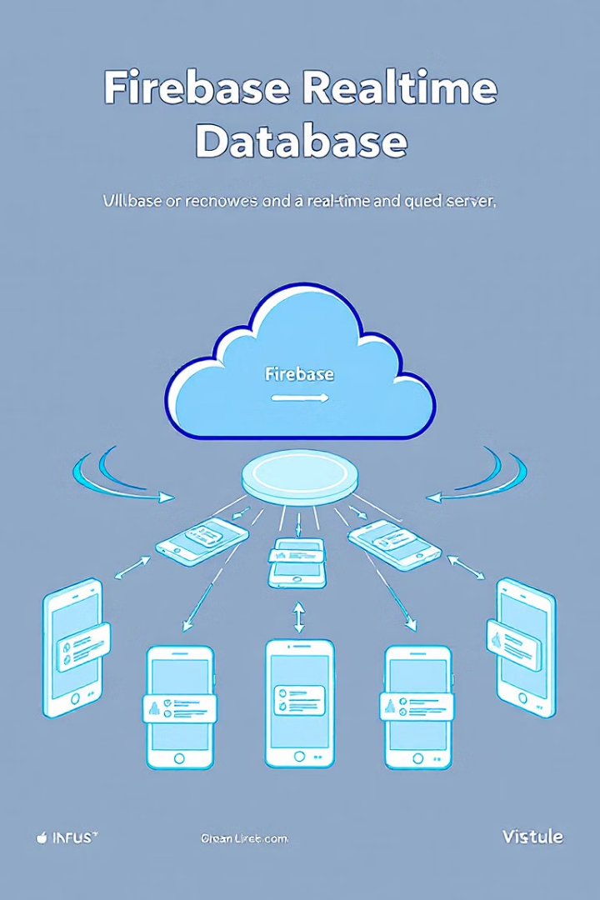


Real-time Communication with Firebase
What is Firebase Realtime Database?
Real-time Updates
Automatically updates across devices.
NoSQL cloud database for real-time syncing.

Slide 14
Integrating Firebase in Flutter
Setup Steps
import 'package:firebase_core/firebase_core.dart';
void main() async { WidgetsFlutterBinding.ensureInitialized();
await Firebase.initializeApp(); runApp(MyApp());
}
Add Firebase
Add Firebase to your project.
Install Packages
Install firebase_core and firebase_database packages.

Slide 15
Reading and Writing Data in Firebase
Writing Data
Reading Data
import 'package:firebase_database/firebase_database.dart’;
final databaseRef = FirebaseDatabase.instance.ref(); void addData() {
databaseRef.child("users").set(
{ "name": "Alice", "email": "alice@example.com" }
);
}
databaseRef.child("users").once().then(
(snapshot)
{
print(snapshot.snapshot.value);
}
);

Slide 16
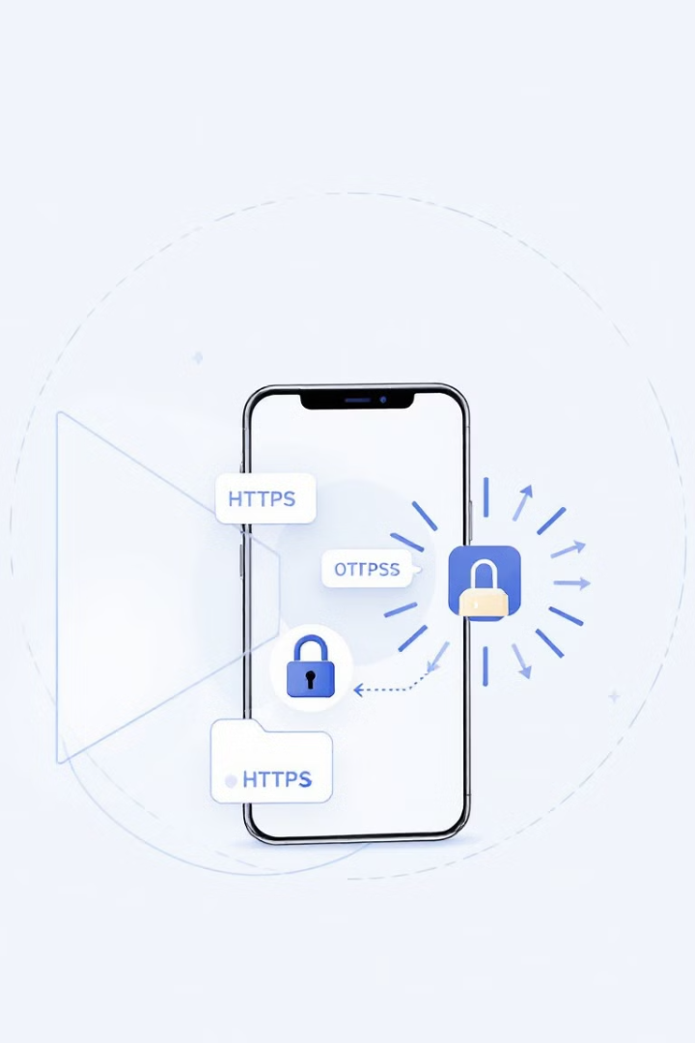
Design Considerations for Secure Mobile Data Transfer
1
Use HTTPS for secure communication.
2
Authenticate API requests using tokens (OAuth, JWT).
3
Encrypt sensitive data before sending.
4
Validate user inputs to prevent attacks.

Slide 17
Thank You

